Slide 1


FYP Internal Presentation
1
Notes:
1

Slide 2

Interior Designing Application
Supervised by:
Dr. Yasir Ali Shah
Group Members:
Ammara Sajjad (FA17-BSCS-071)
Syeda Masooma Zehra (FA17-BSCS-078)
Presented on Jun 1, 2021
Department of Computer Science
COMSATS University Islamabad,
Attock Campus
1/6/2021
FYP Internal Presentation
2

Slide 3
Outline
_______________________________
Introduction
Related Work / Applications
Comparison Table
Problem statement
Objectives
Methodology
Features
Modern tools
Benefit
Implementation
Timeline
References
Future Work
_______________________________
1/6/2020
FYP Internal Presentation
3
Notes:
3

Slide 4

Introduction
_______________________________
This project is about Interior Designing that provide lots of facilities to the customer.
This is an online Android Application for different events designing.
It will assist in designing for those people who have lack of expertise so that they can design their events efficiently.
_______________________________
1/6/2021
FYP Internal Presentation
4

Slide 5
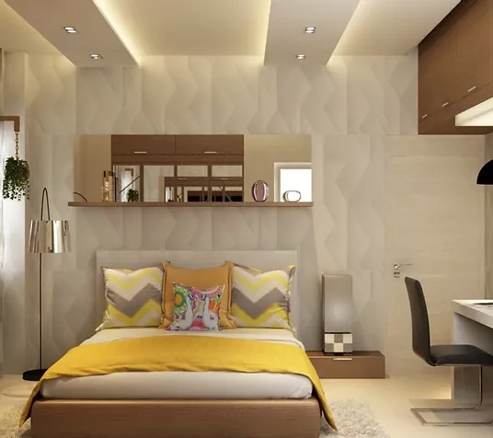
Introduction
_______________________________
As Project deals with:
Residential Interiors
_______________________________
1/6/2021
FYP Internal Presentation
5

Slide 6

Introduction
_______________________________
Commercial Interiors
_______________________________
1/6/2021
FYP Internal Presentation
6

Slide 7
Related Work / Applications
_______________________________
Other interior designing online companies are:
PFuner E-Design Service
Houzz Online Interior Design AR Tool
Traci Connell Design Delivered
_______________________________
1/6/2021
FYP Internal Presentation
7

Slide 8
Comparison Table
_______________________________
Functionality | Interior Designing Application (Proposed) | PFuner E-Design Services | Houzz Online Interior Design AR Tool | Traci Connell Design Delivered
Different Events | ✔ | ✔ | ✔ | ✔
Sample Items (Gallery) | ✔ | ✔ | ✔ | ✔
Customization | ✔ | ✖ | ✔ | ✔
Buy Items | ✔ | ✖ | ✖ | ✔
Estimated Bill | ✔ | ✔ | ✔ | ✔
Chatbot | ✔ | ✖ | ✖ | ✖
Different Teams | ✔ | ✖ | ✖ | ✖
_______________________________
1/6/2021
FYP Internal Presentation
8

Slide 9
Problem Statement
_______________________________
People are less involved in online interior designing because they feel difficulty to design their interior, so we are providing an application that has many features.
To facilitate the people that are busy in their tough schedule and have lack of expertise to manage their events according to their requirements.
_______________________________
1/6/2021
FYP Internal Presentation
9

Slide 10
Objectives
_______________________________
To provide a platform of interior designing for users.
To create an application which will assist in designing multiple categories and subdivided categories of events.
To facilitate the user by different teams of designers.
To take feedback for the purpose of evaluation in the form of rating.
_______________________________
1/6/2021
FYP Internal Presentation
10

Slide 11
Continued….
_______________________________
To generate an estimated bill for demanded services before placing an order.
To provide chatting facility by Chatbot.
To facilitate the customer, sample images will be displayed in the gallery so that team will be easily chosen according to their requirements.
To provide real look and feel to the customer ,customization option will provide some suggestions and testing facility that will help user in customizing their places.
_______________________________
1/6/2021
FYP Internal Presentation
11

Slide 12
Methodology
_______________________________
The requirements of customers will be fulfilled in the field of interior designing through different events and related designing services.
The methodology of this Android Application is:
_______________________________
1/6/2021
FYP Internal Presentation
12

Slide 13
Register
View Details
Buy Items
No
Chatting
User exists?
Customers
Select Team
Menu
Events
Different services
Yes
Real Time Customization
Customization
Order
Start
Placement of Items
For Suggestions
Rating
No
Register
User exists?
Teams
Fingerprint recognition
Customer Details
Order Details
Yes

Slide 14
Sequence Diagram: Customer
_______________________________
User
Android App
Database
Unity
IBM Cloud
1: Enter information
2: Verify
4: Login Successfully
3: Return Response
5: Select Team
6: Show Menu
7: Avail Different Services
8: Request for Customization
10: Show Response
9: Respond
11: Request for Chatting
13: Show Response
12: Respond
_______________________________
1/6/2021
FYP Internal Presentation
14

Slide 15
Sequence Diagram: Team
_______________________________
Team
Android App
Database
Fingerprint
1: Enter information
2: Verify
3: Return Response
4: Request for fingerprint authentication
6: Login Successfully
5: Respond
7: See Details of customer
8: Request send
10: Show Response
9: Respond
_______________________________
1/6/2021
FYP Internal Presentation
15

Slide 16
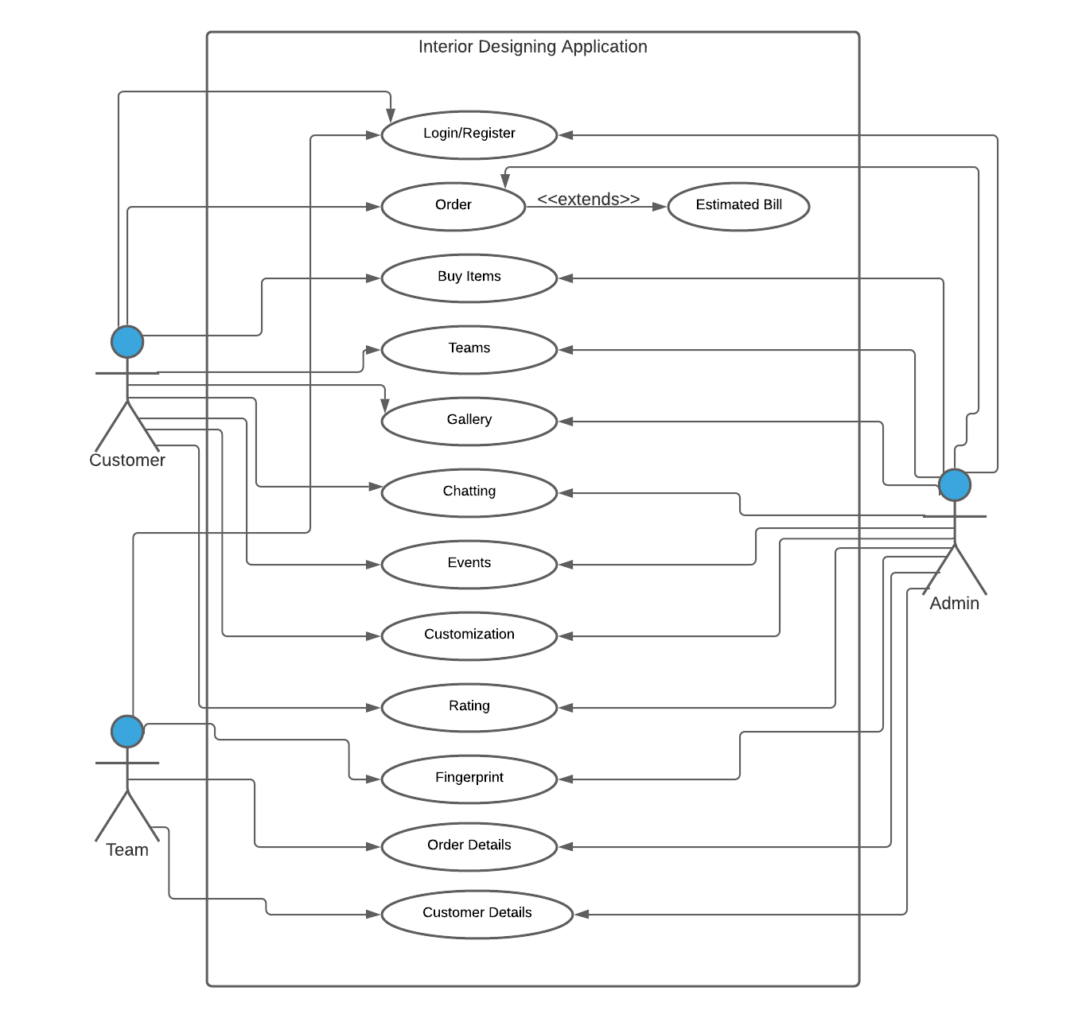
Use Case Diagram
_______________________________
_______________________________
1/6/2021
FYP Internal Presentation
16

Slide 17
Features
_______________________________
Different events
Coloring Scheme (image display in suggestions)
Multiple teams
Team's rating
Item positioning through customization.
Estimated bill
_______________________________
1/6/2021
FYP Internal Presentation
17

Slide 18
Other Features
_______________________________
Fingerprint recognition for advanced security of team members.
User can cancel their order before confirmation.
Subdivided services of events (decorations and catering etc.)
Chatting through Chatbot.
Sample images will display in gallery to attract users.
_______________________________
1/6/2021
FYP Internal Presentation
18

Slide 19
Modern Tools
_______________________________
Tools | Version | Rationale
IBM Cloud | - | Artificial Intelligence
Firebase | 7.1.0 | Database
Android studio | 4.2.1 | Programming
Unity | 2020.3.0f1 | Customization
MS word | 2019 | Documentation
MS Power Point | 2019 | Presentation
_______________________________
1/6/2021
FYP Internal Presentation
19

Slide 20
Benefits
_______________________________
Application will give following benefits:
Offers lots of services to save time.
Sample pictures (through Gallery and suggestions).
Different categories of events.
Specific teams (Ratings).
Chatting Facility.
Real Environment (through image customization).
_______________________________
1/6/2021
FYP Internal Presentation
20

Slide 21
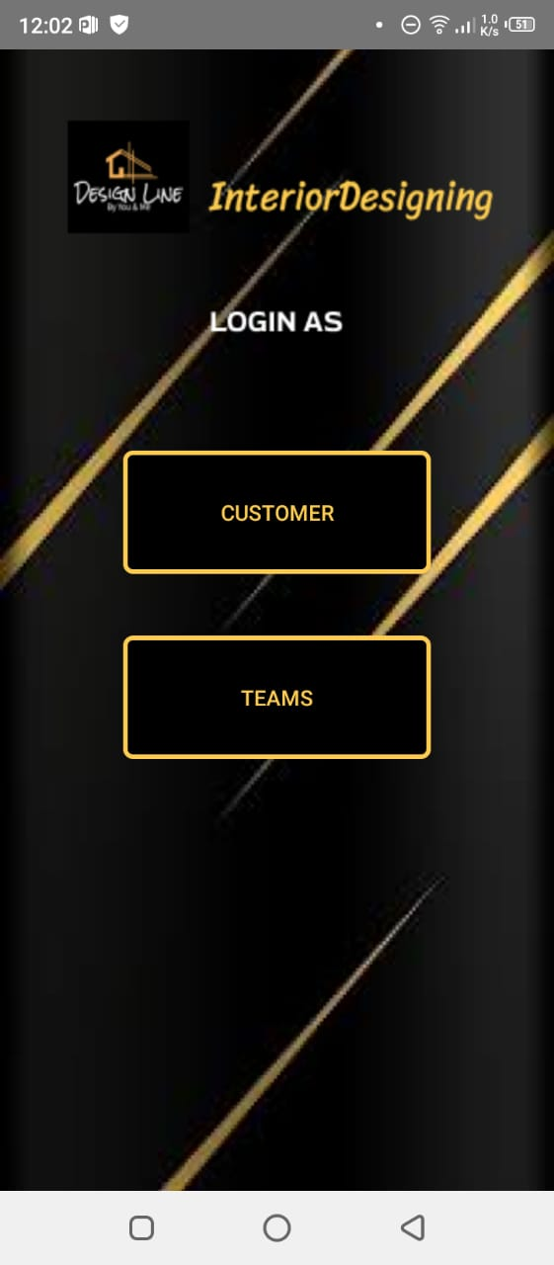
Implementation: Main Module
_______________________________
_______________________________
1/6/2021
FYP internal Presentation
21

Slide 22
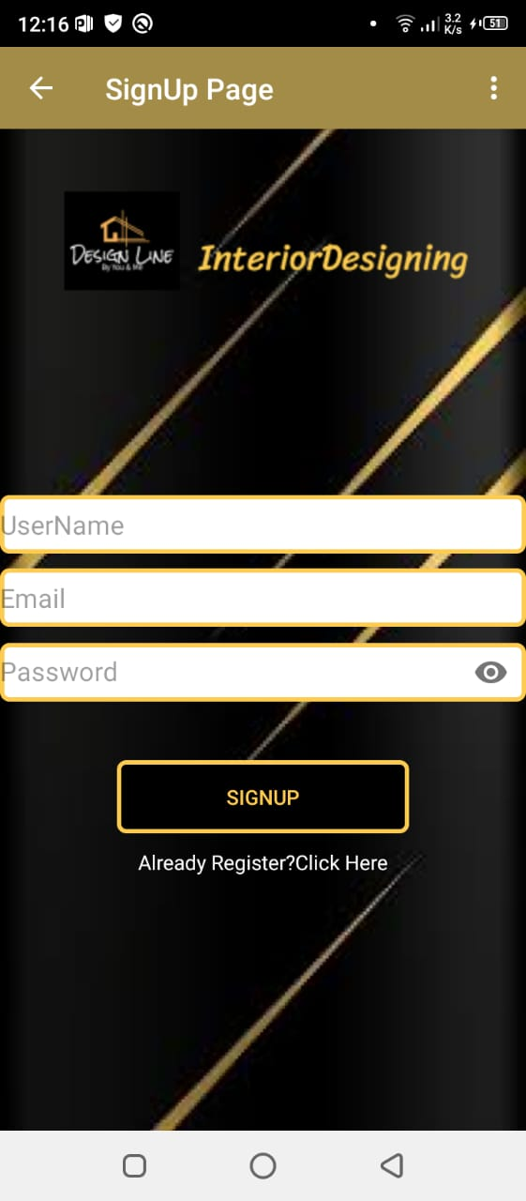
1:Customer
_______________________________
New user will signup first.
_______________________________
1/6/2021
FYP Internal Presentation
22

Slide 23
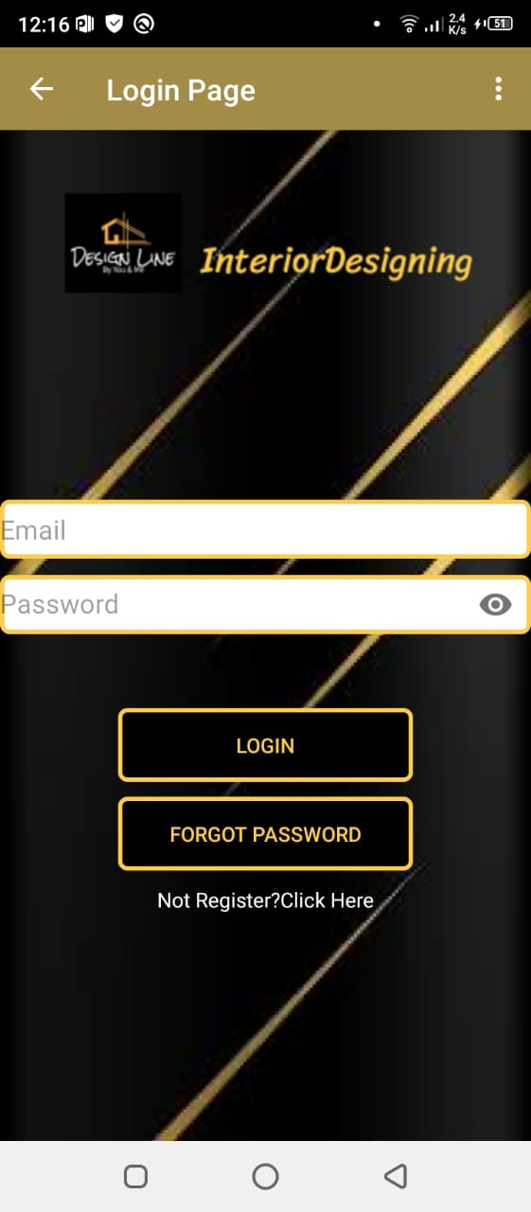
Continued….
_______________________________
Login Page for Customer.
_______________________________
1/6/2021
FYP Internal Presentation
23

Slide 24
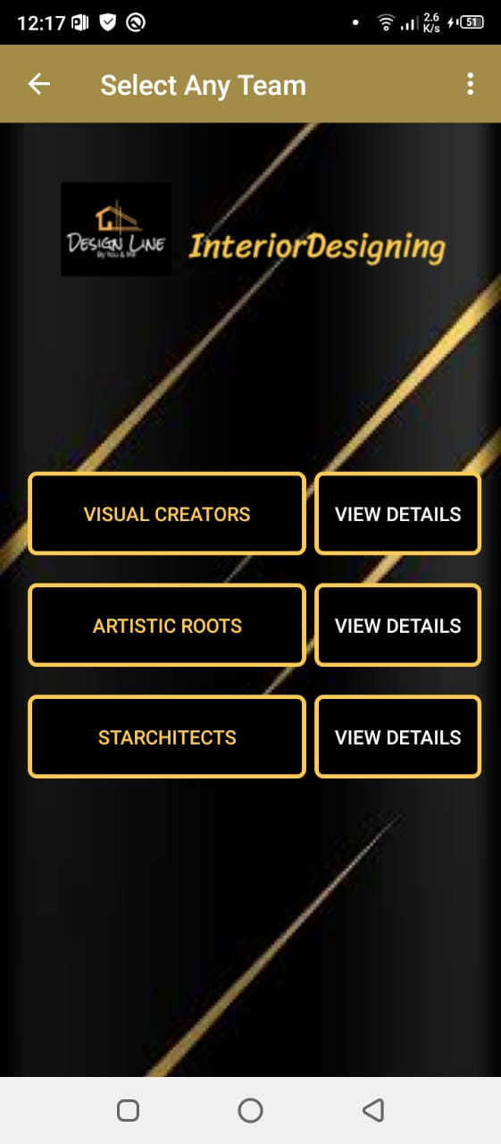
Select Team
_______________________________
Different teams and their details.
_______________________________
1/6/2021
FYP Internal Presentation
24

Slide 25
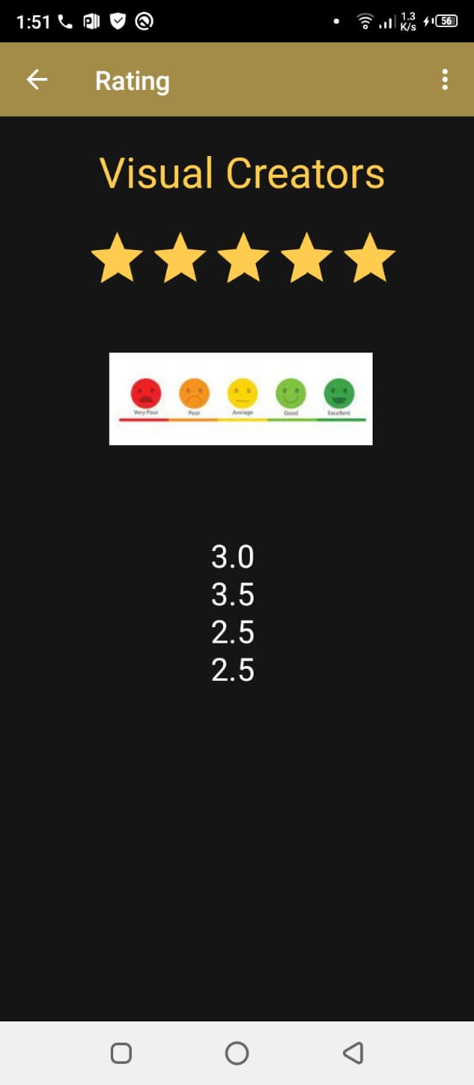
View Details: Rating
_______________________________
Team’s rating by different customers
_______________________________
1/6/2021
FYP Internal Presentation
25

Slide 26
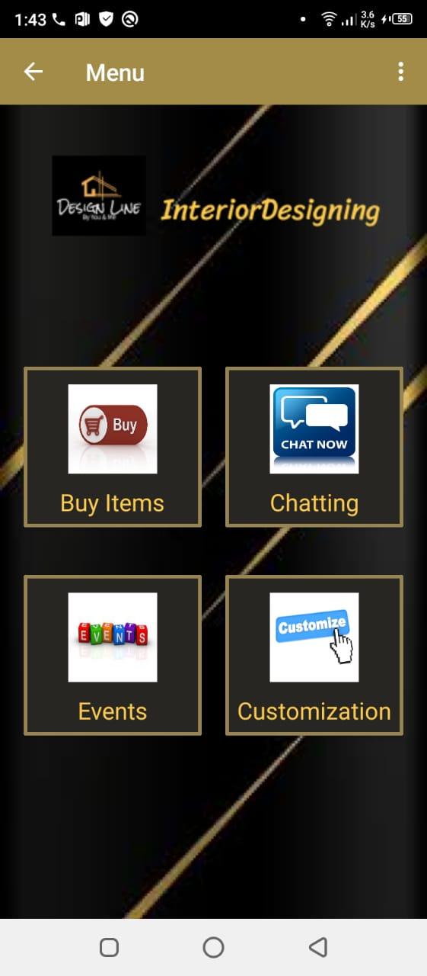
Main Menu
_______________________________
After viewing details, customer will select any team and see main menu.
_______________________________
1/6/2021
FYP Internal Presentation
26

Slide 27
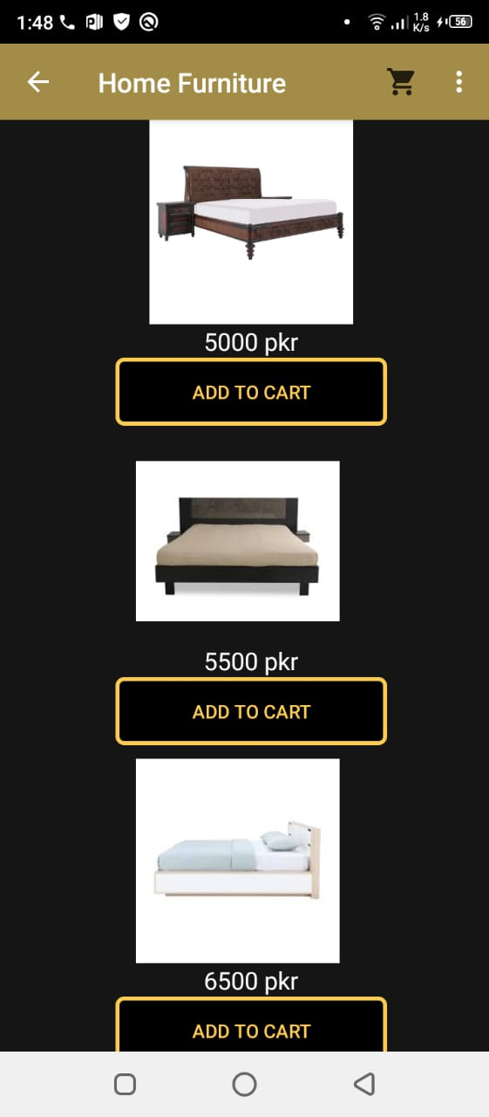
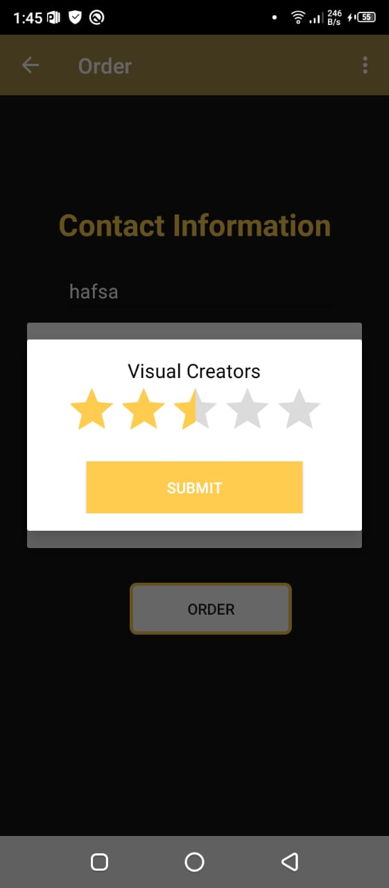
Buy Items: Order & Rating
_______________________________
_______________________________
1/6/2021
FYP InternalPresentation
27

Slide 28
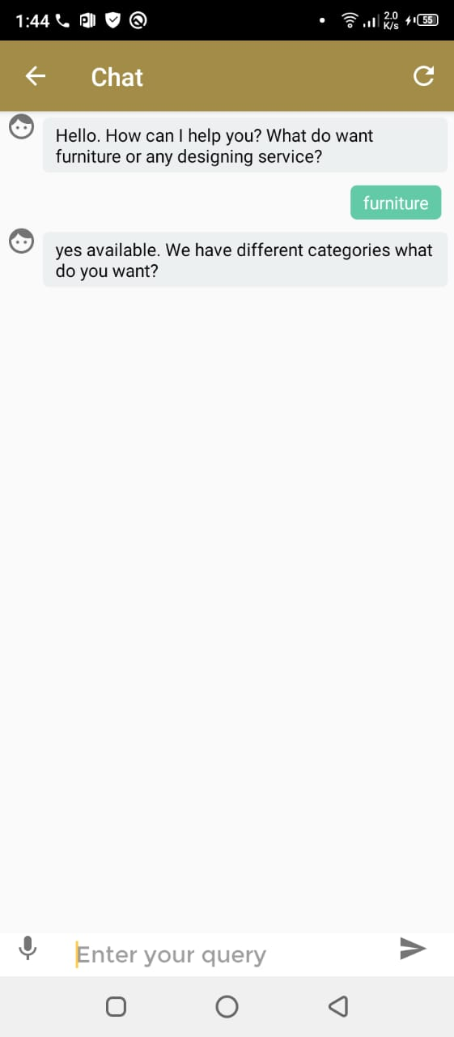
Menu: Chatting
_______________________________
Chatting facility through chatbot
_______________________________
1/6/2021
FYP Internal Presentation
28

Slide 29
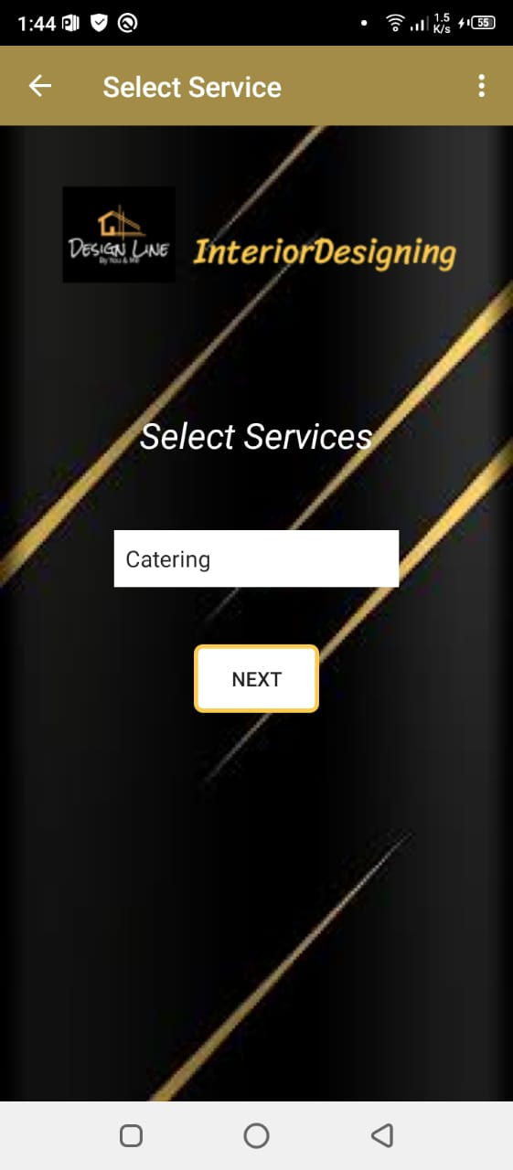
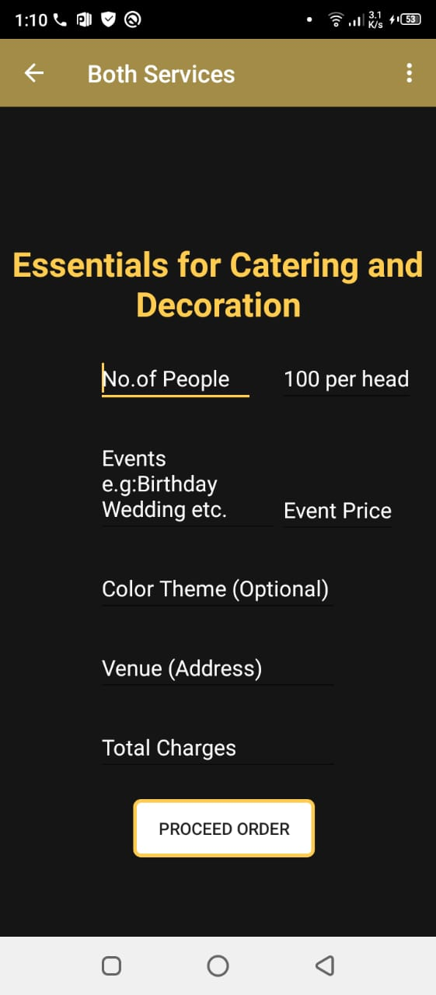
Menu: Events
_______________________________
Different services for different events
_______________________________
1/6/2021
FYP Internal Presentation
29

Slide 30
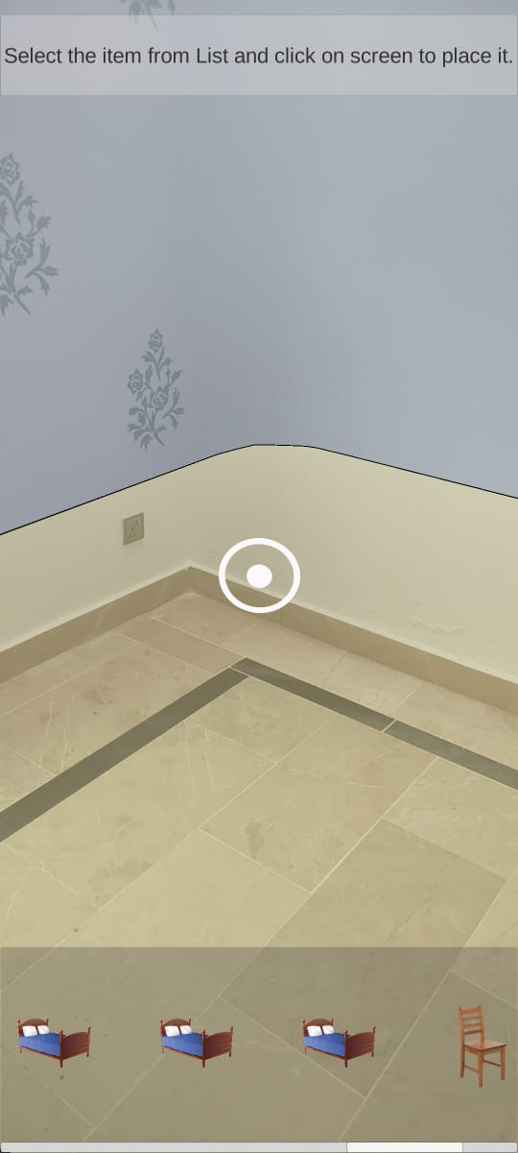
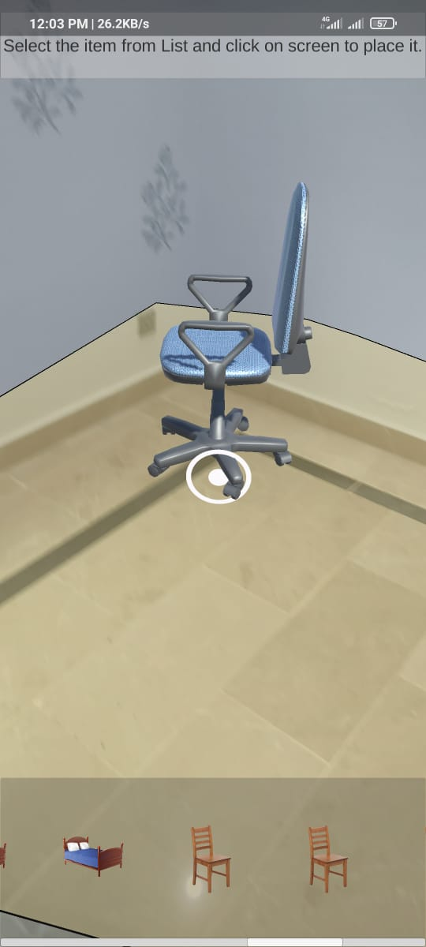
Customization: Real Time
_______________________________
_______________________________
1/6/2021
FYP Internal Presentation
30

Slide 31
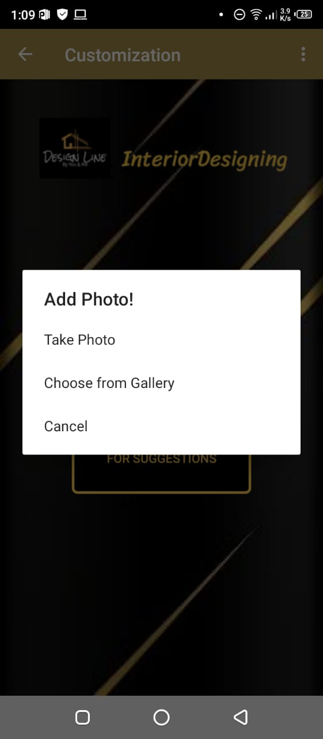
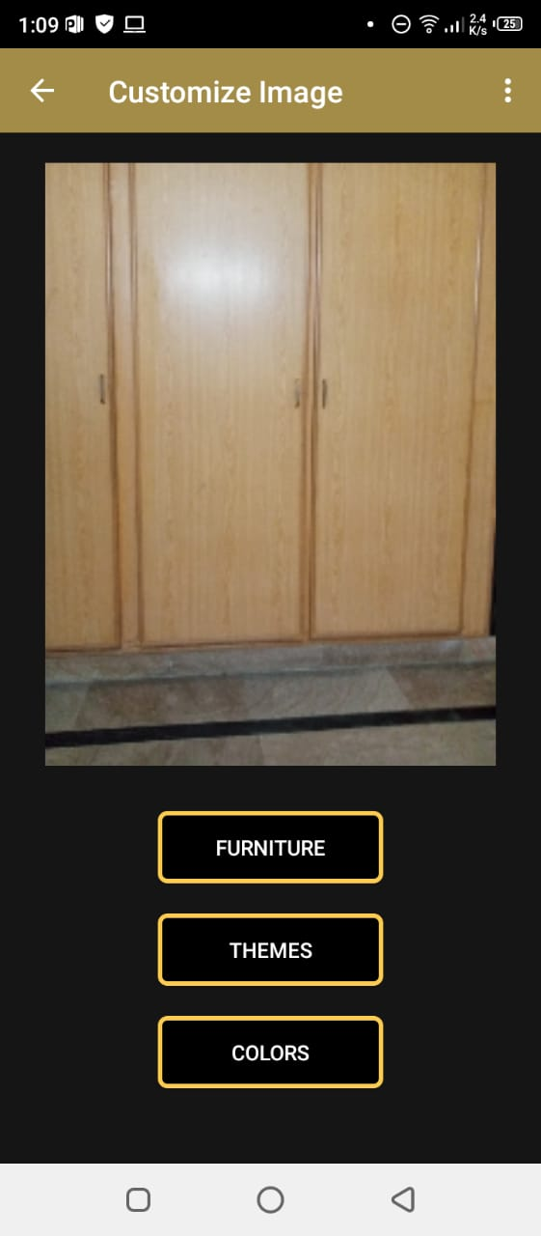
Customization: For Suggestions
_______________________________
_______________________________
1/6/2021
FYP Internal Presentation
31

Slide 32
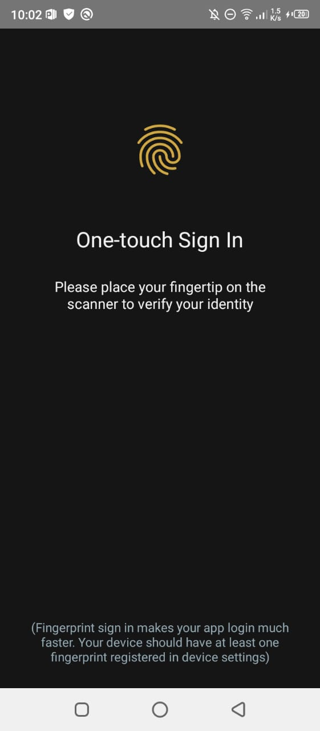
2. Teams: Fingerprint Recognition
_______________________________
For advance security, user will allow to use fingerprint recognition
_______________________________
1/6/2021
FYP Internal Presentation
32

Slide 33
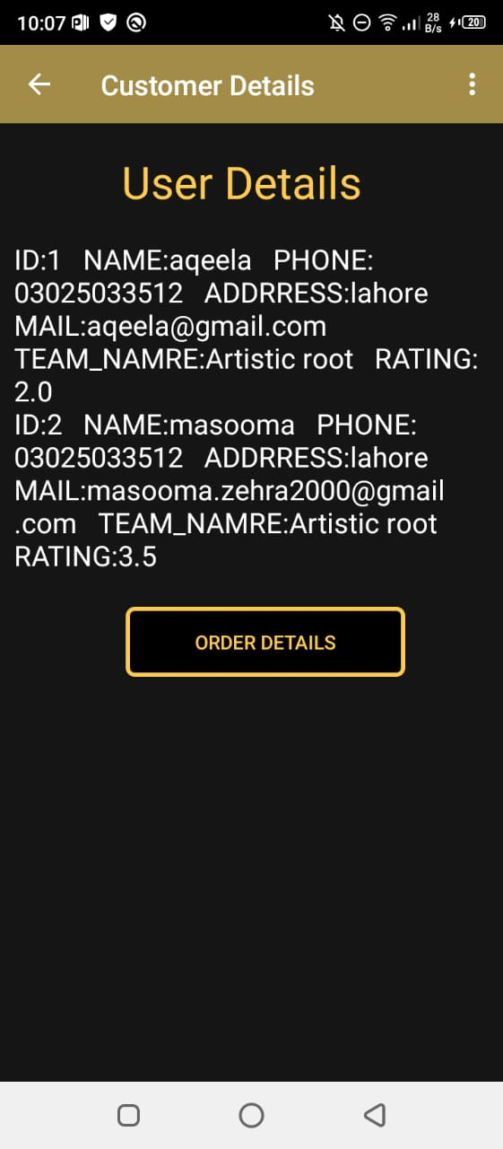
Customer Details
_______________________________
_______________________________
1/6/2021
FYP Internal Presentation
33

Slide 34
Timeline
_______________________________
Milestone | Feb to April 2020 | April to June 2020 | June to Sep 2020 | Sep to Nov 2020 | Nov 2020 to Jan 2021 | Jan to March 2021 | March to May 2021
Literature Review
Designing
Programming
Artificial Intelligence
Interface
Testing
Documentation
_______________________________
1/6/2021
FYP Internal Presentation
34

Slide 35
Future Work
_______________________________
In Customization module, there should be other customizable options such as changing color of background, walls, floor and curtain etc.
For more customization, there should be other items for user to buy such as curtains, rugs and different decoration pieces etc.
This application runs on specific compatible devices for AR, so in future add AR feature in a way that it runs on every android mobile.
ttps://traciconnellinteriors.com/online-design/
_______________________________
1/6/2021
FYP Internal Presentation
35

Slide 36
References
_______________________________
https://pfunerdesign.com/
https://www.houzz.com/mobileApps
https://traciconnellinteriors.com/
ttps://traciconnellinteriors.com/online-design/
_______________________________
1/6/2021
FYP Internal Presentation
36

Slide 37

Notes:
37

